Slide 1

Aligning Connection and Values: Strategic Employee Engagement for Court Professionals
Presenter:
Molly Malone, BA, MA Program Manager – Retention and Enculturation
Kaiser Permanente

Slide 2

Molly Malone Program Manager – Retention & Enculturation
Been with Kaiser Permanente for 16+ years
Master’s degree from Auburn University; Bachelor’s degree from University of Southern Mississippi
Wife and mom of two boys and a rescue dog
Enjoy playing tennis, giving historical tours of my neighborhood for Atlanta Preservation Center and watching Bravo
Notes:
Began 16+years ago
Three components:
Networking – We have a lot of fun with our networking portion and if I had more time, I’d go through some of those exercises with you, but just know it involves singing Whitney Houston as a group.
Education – I will show you our courses momentarily and explain their importance.
LET’S START WITH MENTORING.
Each new hire in Shared Success is paired with a mentor. That person has to have been with TSPMG for over 3 years, volunteer to be a mentor and be in good standing.
Mentors are NOT in the same department as new hires. We try to have them in the same facility, but the emphasis is have new hires get to know people outside of who they work the majority of their time with.
To date, we have had approximately 800 new hires go through our Shared Success program since it’s inception. About 475 mentors… explain repeat mentors.
Which leads me into introducing y’all to my friend Dr. Jackie Anglade and her Shared Success family tree.

Slide 3
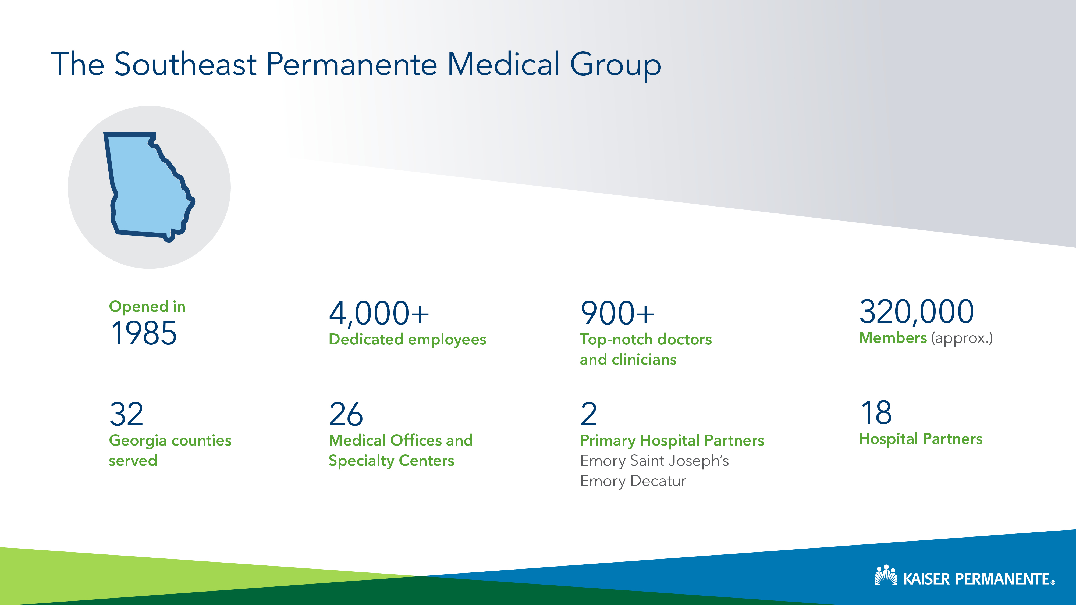
Notes:
•Multi Specialty Medical Practice that exclusively provides care to members of Kaiser Foundation Health Plan (GA)
•1,158 employees in TSPMG - 929 clinicians, 229 admin staff
•TSPMG Mission: To provide high quality affordable health care to our members and the communities we serve

Slide 4

Onboarding 101
Onboarding sets the foundation for a new hire’s success (and will ultimately, make everyone’s jobs easier)
Onboarding should be comprehensive, yet tailored to your court’s unique environment
The onboarding timeline does not end at a new hire’s first day, first week or first month
First impressions are critical, and connections last a lifetime

Slide 5

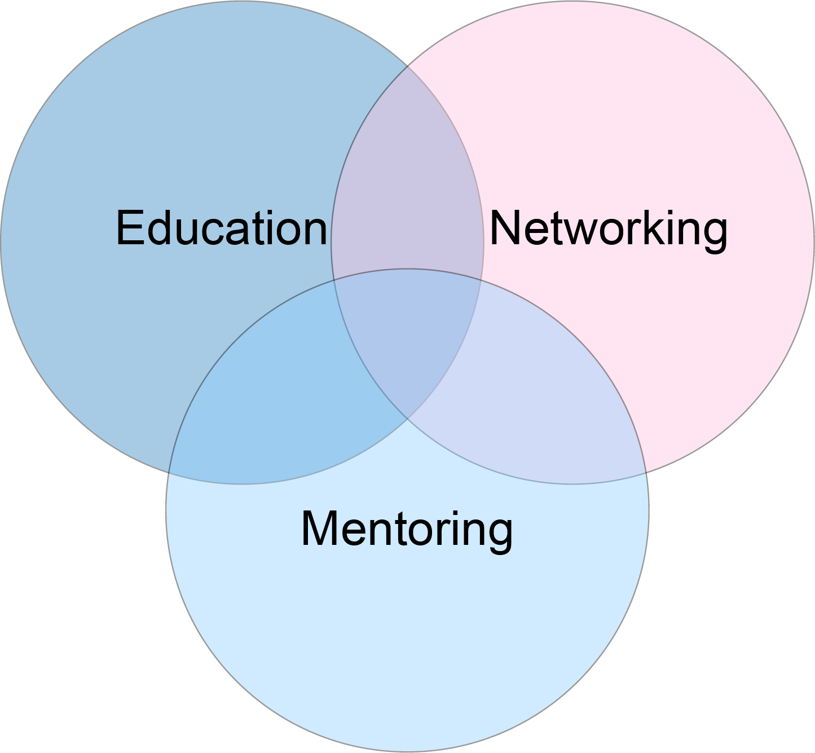
How do you make meaningful connections with your colleagues?
Notes:
Began 16+years ago
Three components:
Networking – We have a lot of fun with our networking portion and if I had more time, I’d go through some of those exercises with you, but just know it involves singing Whitney Houston as a group.
Education – I will show you our courses momentarily and explain their importance.
LET’S START WITH MENTORING.
Each new hire in Shared Success is paired with a mentor. That person has to have been with TSPMG for over 3 years, volunteer to be a mentor and be in good standing.
Mentors are NOT in the same department as new hires. We try to have them in the same facility, but the emphasis is have new hires get to know people outside of who they work the majority of their time with.
To date, we have had approximately 800 new hires go through our Shared Success program since it’s inception. About 475 mentors… explain repeat mentors.
Which leads me into introducing y’all to my friend Dr. Jackie Anglade and her Shared Success family tree.

Slide 6
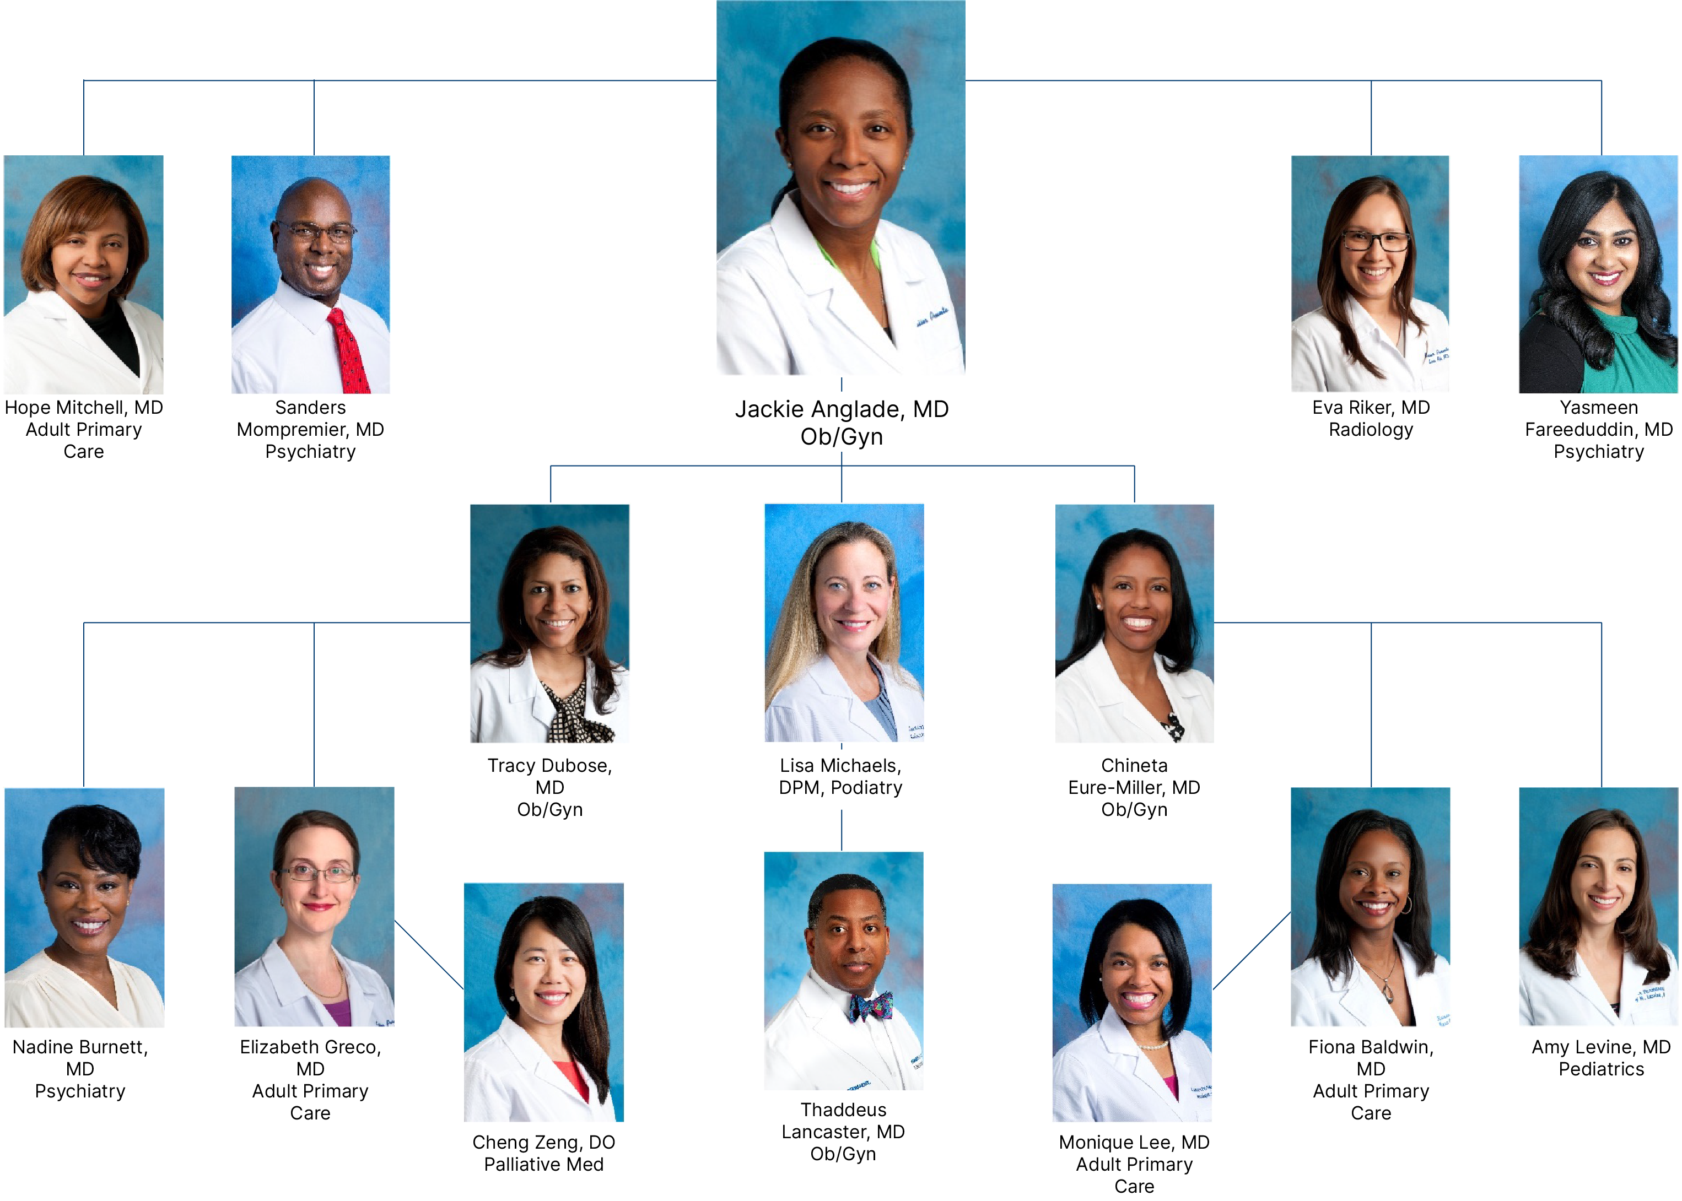
One Mentor’s Impact: A Shared Success Family Tree
Notes:
- This is an example of what it could look like in a larger court system, but smaller scaled “family trees” are just as productive in smaller court systems as well.
Being a mentor in Shared Success is a privilege many of our doctors seek out, and once they become a mentor, they almost always want to be one again.
Jackie is an example of one of our Legacy Mentors, and what you see here is a small sample of her Shared Success Family Tree.
In the time since Jackie started mentor in Shared Success, she has gone from being an individual contributor to holding multiple leadership roles. She is currently the Physician in Charge of our East Area.
You can see some of her new hires attached to her picture and then their new hires. Jackie is very proud of not only being a mentor, a grand mentor and a great-grand mentor in Shared Success, but she has been able to help influence some of her “family” in getting into leadership roles in the organization as well.

Slide 7
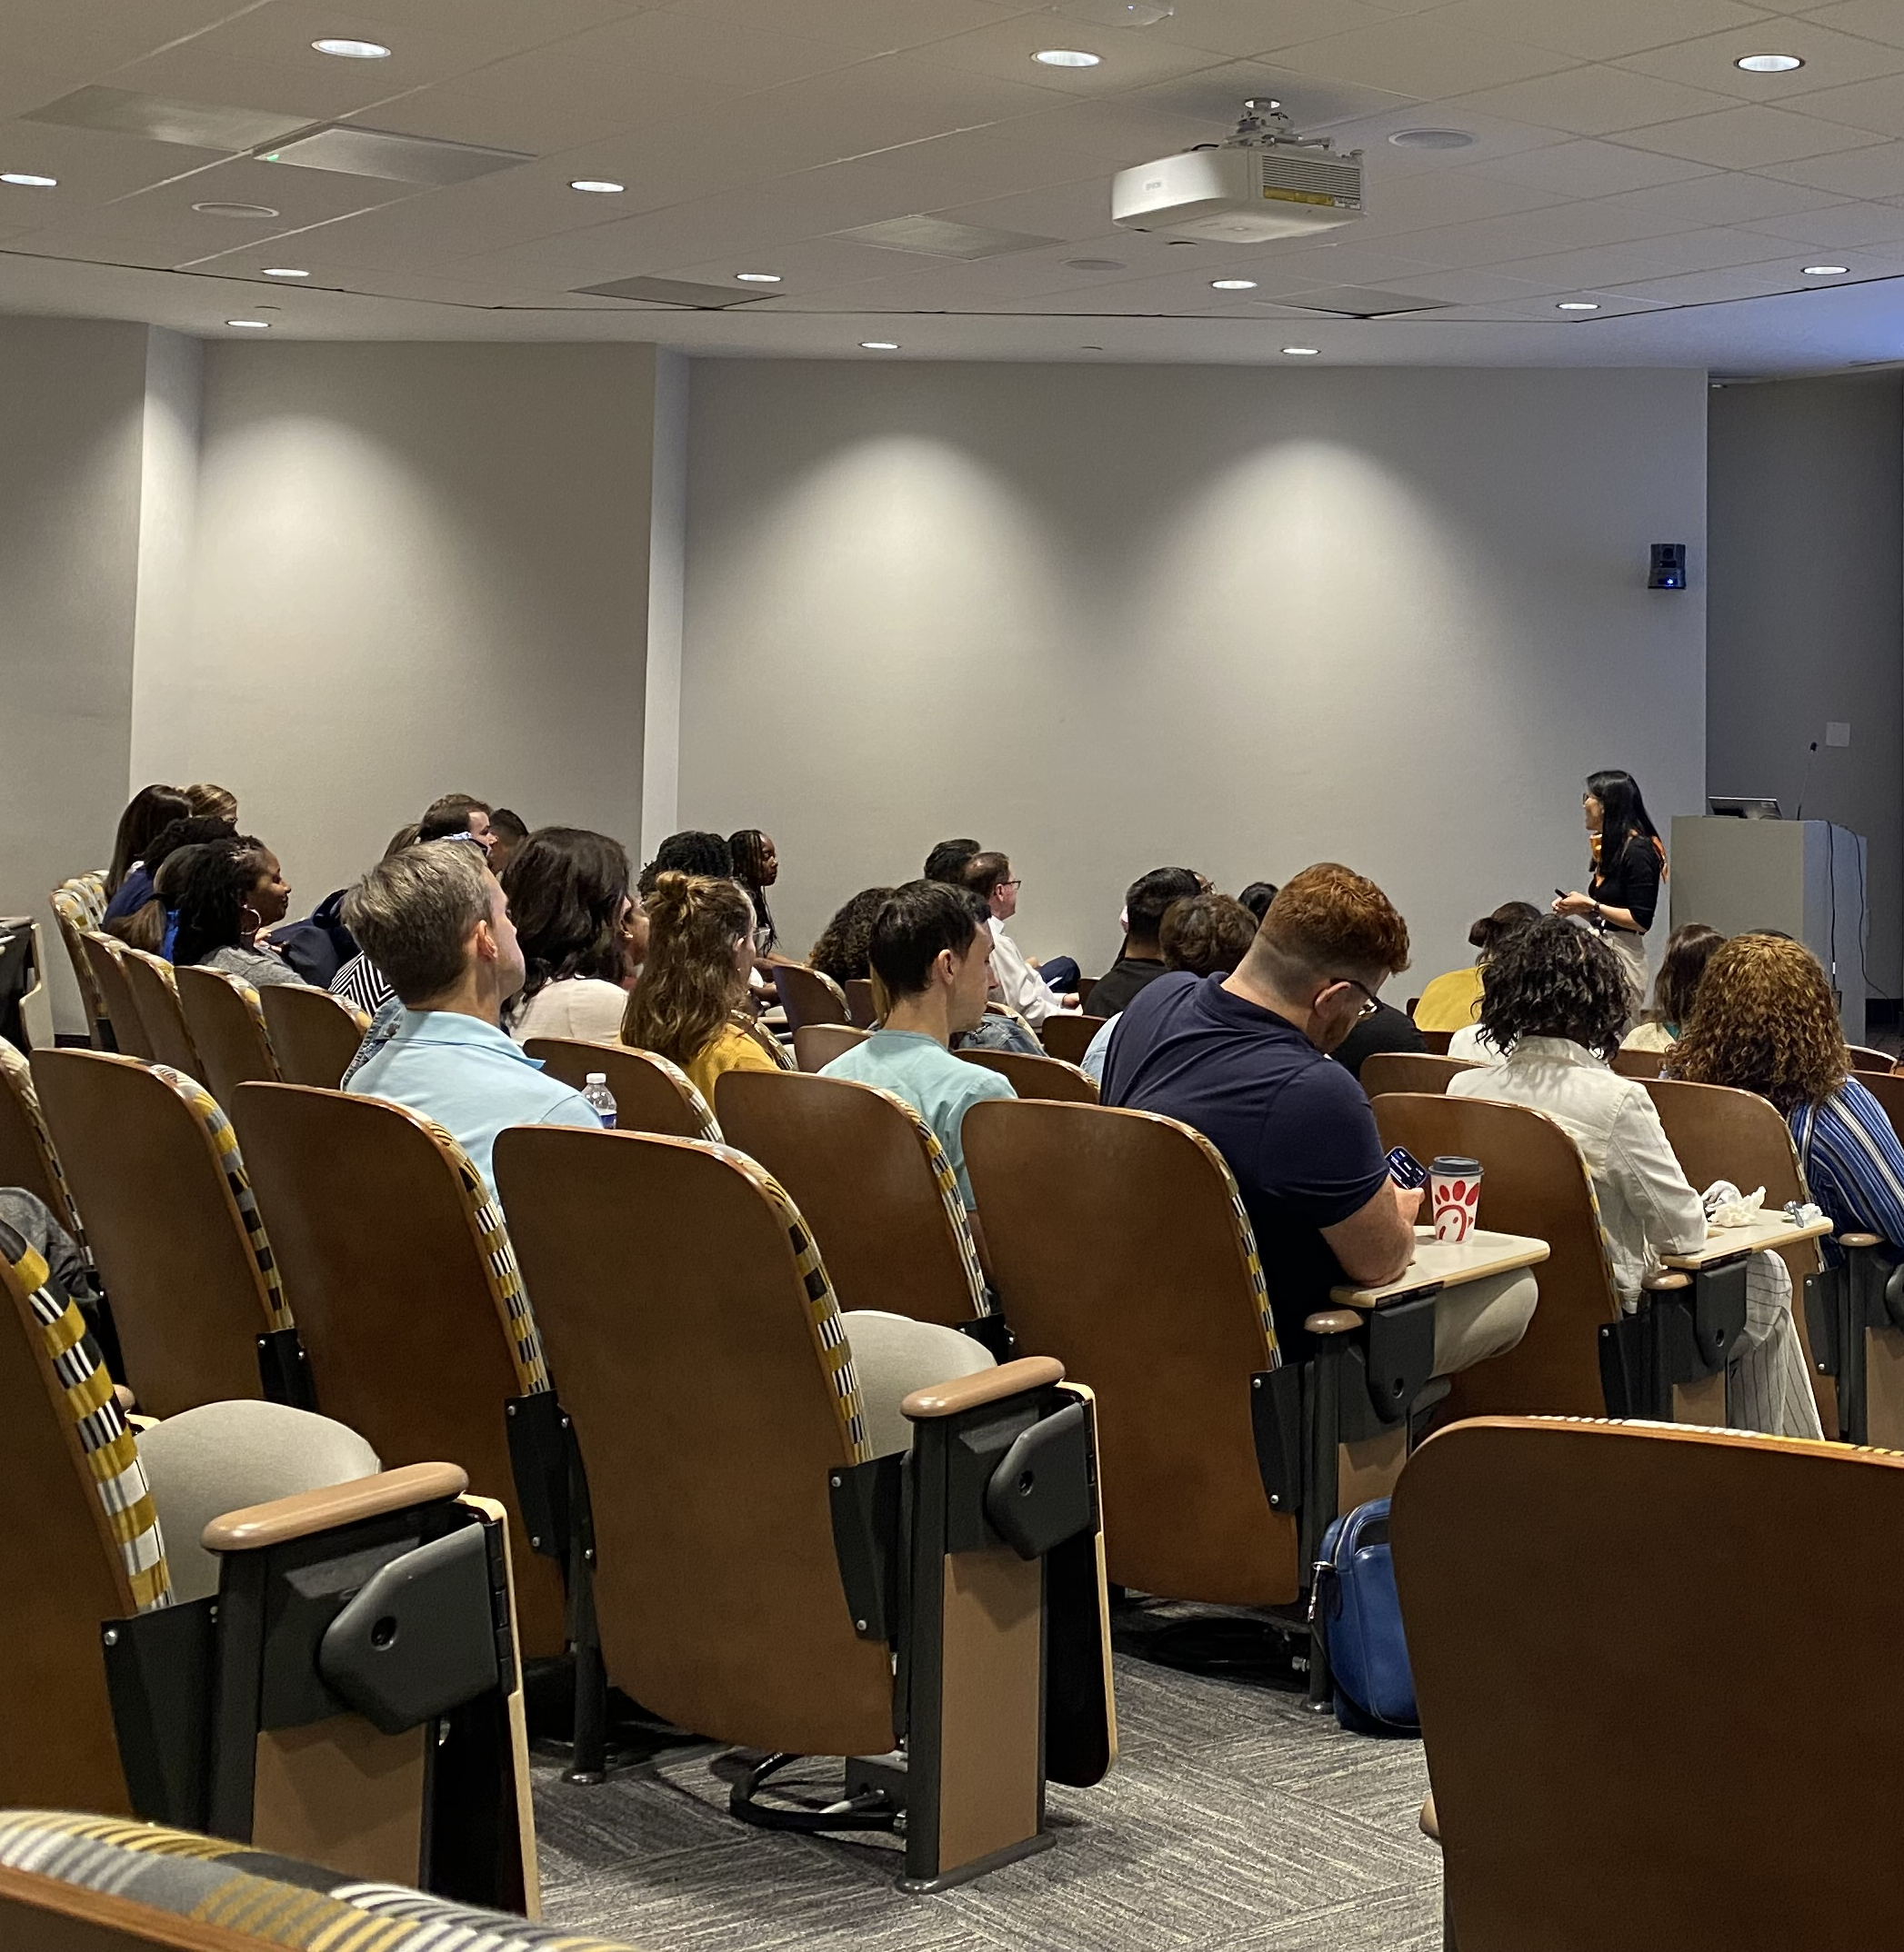
Topics to Consider
About your Court
Court structure
Policies and procedures
Ethics
Tour of your surroundings
About your Municipality
History
Facts and figures
About your Systems
Case management software
Compliance training
Data and document management
Notes:
If you are in a larger court system, this could be a program you are having every year on a rolling basis with set dates. Content can be independent of each other so that new hires can join into the sessions as they onboard instead of having to wait to a new year to join.
If you are in a smaller or medium sized court system, this could be held as a “lunch and learn” type of environment with seasoned employees and the new hire attending.
So often we find that our mentors in these programs are getting more out of the sessions than the new hires. A new hire is constantly learning and doesn’t know what they don’t know. A seasoned employee can relate and give examples of why changes are helpful, give historical background, and provide feedback on changes that can be made.

Slide 8

Furthering a Culture of Communication
Open lines of communication is a driver in higher employee satisfaction across industries
What connection points would be important for our court administrators and other court contributors and leaders to discuss together?
Ethics and accountability
External relationships
Law enforcement
Attorneys
Community Organizations
Understanding the hierarchy
Notes:
Post Covid, we saw how some of the culture we had been building for over a decade had started eroding away, through no fault of our own. The lack of interpersonal communication and collaboration during Covid was taking its toll on our medical group. People didn’t know each other anymore, and being a multi-specialty medical group, our collaboration is our super power.
We were also in the “Great Resignation” where many physicians, as well as people across all lines of work, were leaving their jobs for something else – whether that being an early retirement, moving elsewhere or changing their career entirely. Covid had changed the way we worked, the we way we thought and the way we felt about our careers and our jobs. We needed to evolve Shared Success into a space that continued and expanded our lines of communication with leaders at a top level while maintaining psychological safety to our physician during heavy and hard conversations.
Some of the topics that were bubbling to the top around this time were heavy. And hard. And we needed to show up for our physicians the way we know they show up for their patients. So we did just that. We looked at exit interviews. We asked our colleagues. We had physician leaders round in the clinics and then we took that info and targeted our messaging and efforts in how we show up for our people.

Slide 9

Leadership Involvement
Encouraging diverse perspectives and modeling a speak-up culture
Connections between front-line to executive, as well as middle management
Able to create solutions quickly, efficiently and work together
Instituting in-person Q&A sessions and follow-up processes for concerns that may not be reaching our top executives
Notes:
Leadership involvement with Shared Success
Talk about problems that have been solved (i.e. Surgery Scheduling)

Slide 10

Data driving us forward
Physician exit interview data for 2022 and 2023 has listed that Shared Success was a top three satisfier in their time with TSPMG
Lower turnover rates than the national average for physicians
Annual Engagement Survey data showed a two-point increase in engagement from 2022 to 2023
Annual Engagement Survey data showed a three-point increase in culture of health from 2022 to 2023
Notes:
This continues to help make medicine a more sustainable career choice for our physicians. The connections made during Shared Success, whether it be through mentorship, networking or with senior leadership continue to thrive even after the completion of the program. Around 70% of new hires who complete Shared Success ask to come back and be mentors in the program when they are eligible.
During 2021, we saw our rates increase to turnover for physicians, but since then we have seen our rates decrease and steady to around 5%.

Slide 11

Intersectionality Activity: Driving Connection
There isn’t one attribute that tells us exactly who we are. The many pieces and parts that make you YOU are what makes us special and makes our teams special.
Learning more about each other is one of the many ways we can bond and support each other through our work and through our lives.

Slide 12

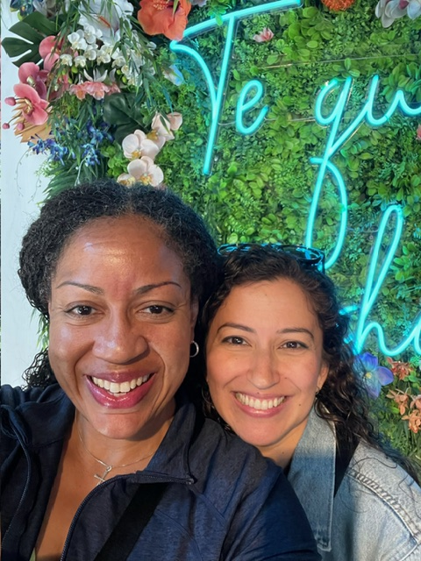
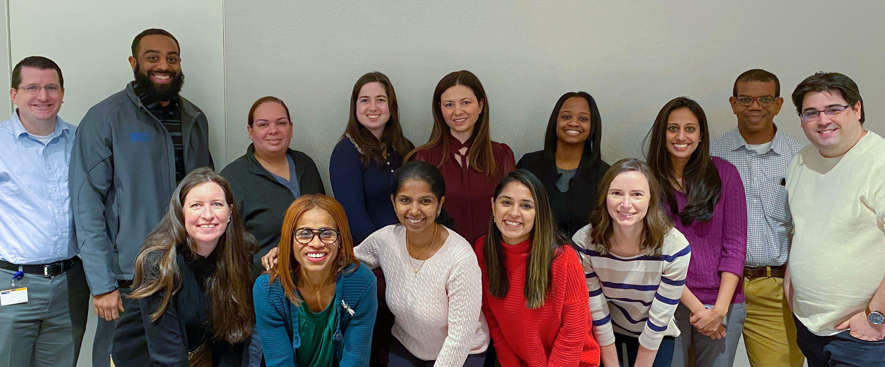

Questions?

